Slide 1
Lecture 6 Linear Regression
Faculty of Computer Science
Data Analysis
Moscow 2022
Lecturer: Alisa Melikyan, amelikyan@hse.ru, PhD,
Associate Professor of the School of Software Engineering

Slide 2
Regression analysis
Data Analysis
Lecture 6
Linear Regression
Regression analysis is a set of statistical methods used to estimate relationships between a dependent variable and one or more independent variables. It depicts how dependent variable will change when one or more independent variable changes. The results of regression analysis can be used to forecast the values of the dependent variable. One point to keep in mind with regression analysis is that causal relationships among the variables cannot be determined. While the terminology is such that we say that X "predicts" Y, we cannot say that X "causes" Y. Wile forecasting we should also take into account how external factors could affect the values of the dependent variable.

Slide 3
Linear regression
Data Analysis
Lecture 6
Linear Regression
Linear regression analysis rests on the assumption that the dependent variable is continuous. The independent variables can be either continuous or dichotomous. Independent variables with more than two levels can also be used in regression analyses, but they first must be converted into variables that have only two levels. This is called dummy coding.

Slide 4
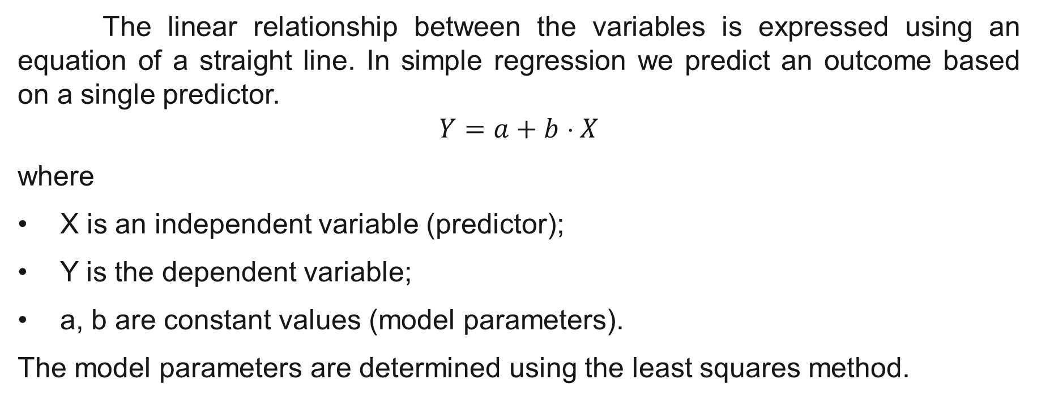
Simple linear regression
Data Analysis
Lecture 6
Linear Regression
The linear relationship between the variables is expressed using an equation of a straight line. In simple regression we predict an outcome based on a single predictor.
$$Y=a+b \text{⋅} X$$
where
X is an independent variable (predictor);
Y is the dependent variable;
a, b are constant values (model parameters).
The model parameters are determined using the least squares method.

Slide 5
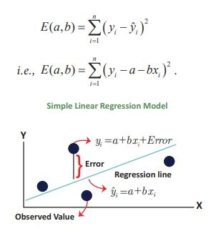
Method of least squares
Data Analysis
Lecture 6
Linear Regression
Method of least squares is a way of finding the line that best fits the data (i.e. the line that goes through, or is close to, as many of the data points as possible).

Slide 6
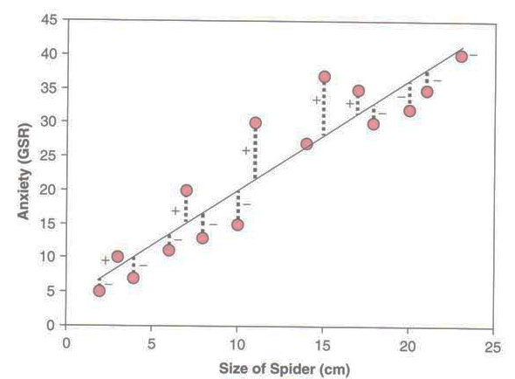
Data Analysis
Lecture 6
Linear Regression
This graph shows a scatterplot of some data with a line representing the general trend. The vertical lines (dashed) represent the differences (or residuals) between the line and the actual data. The method of least squares works by selecting the line that has the lowest sum of squared differences.

Slide 7
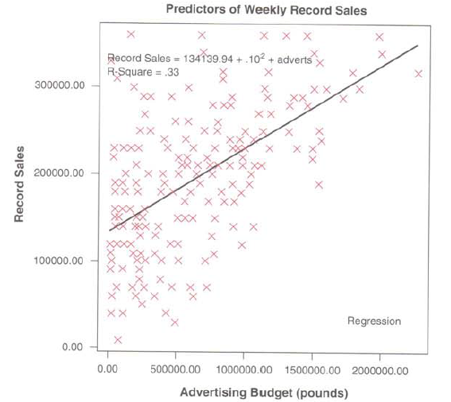
Data Analysis
Lecture 6
Linear Regression
In order to evaluate how well a straight line expresses the relationship between variables, it is useful to examine the scatterplot to see if there is a linear relationship and to detect outliers that can significantly skew the result.

Slide 8
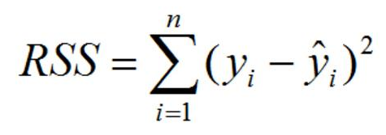
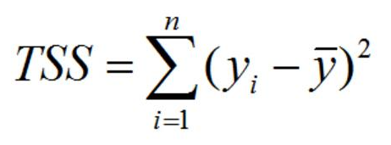
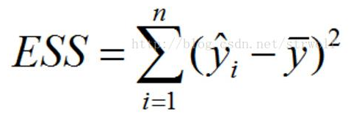
Sum of squares
Data Analysis
Lecture 6
Linear Regression
Residual Sum of Squares (RSS)
Total Sum of Squares (TSS)
Explained Sum of Squares (ESS)
TSS = RSS + ESS

Slide 9
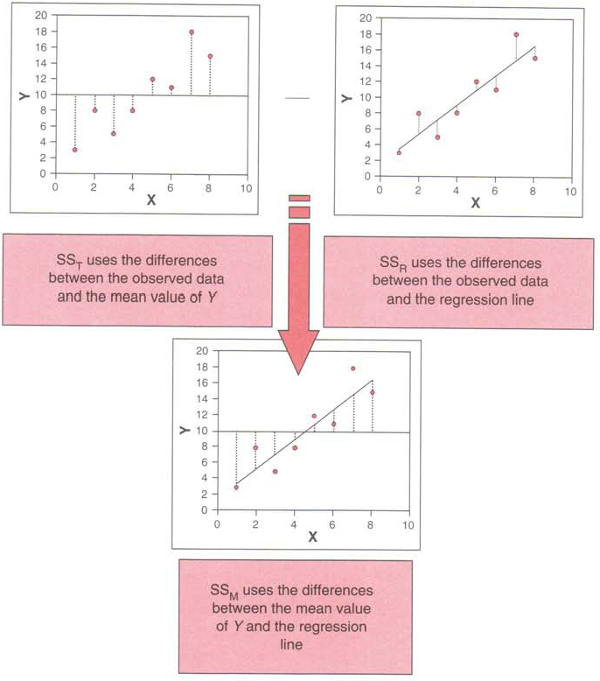
Data Analysis
Lecture 6
Linear Regression

Slide 10
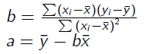
Simple linear regression: example
Data Analysis
Lecture 6
Linear Regression
X | Y
1 | 5
2 | 3
4 | 4
7 | 6
9 | 12
Y = 0,8*X + 2

Slide 11
Multiple Linear Regression
Data Analysis
Lecture 6
Linear Regression
The multiple regression model supposes that we have more than one predictor. Each predictor variable has it’s own coefficient, and the outcome variable is predicted from a combination of all the variables multiplied by their respective coefficients plus a residual term.
Y_{i} = (b₀ + b₁X₁ + b₂X₂ + … + b_{n}X_{n} ) + e_{i}

Slide 12
Regression Equation
Data Analysis
Lecture 6
Linear Regression
Y_{i} = (b₀ + b₁X₁ + b₂X₂ + … + b_{n}X_{n} ) + e_{i}
In the equation:
b₁ is the coefficient of the first predictor (X₁);
b_{n} is the coefficient of the n^{th} predictor (X_{n});
e_{i} is the difference between the predicted and the observed value of Y for the i^{th} participant.

Slide 13
Selection of predictors
Data Analysis
Lecture 6
Linear Regression
The predictors included and the way in which they are entered into the model can have an impact on the final result. It is recommended to select predictors based on past research (but it’s necessary to be sure that the past research was done appropriately). The selection could be also based of the theoretical framework of the research.

Slide 14
Adding categorical predictors into the model
Data Analysis
Lecture 6
Linear Regression
If the variable is dichotomous it could be added into the model without any preliminary transformation.
If the categorical variable has more than two values it should be recoded into several dummy variables. Each group of cases, defined by the values of the categorical variable, should contain not less then 15% of cases.

Slide 15
Creating dummy variables
Data Analysis
Lecture 6
Linear Regression
If the categorical variable has n values we will enter into the model n-1 dichotomous variables.
One category is selected as a “basic” or “reference” and the other categories will be compared with this “basic” category. It could be a category, which contains the biggest number of cases.

Slide 16
Creating dummy variables
Data Analysis
Lecture 6
Linear Regression
The initial variable "Educational level" takes the following values: no (1), secondary (2), higher (3), postgraduate (4). We can choose "higher" as a reference group.
Educational level
Higher
No
Secondary
Postgraduate
Higher
Secondary
Ed_no | Ed_secondary | Ed_postgraduate
0 | 0 | 0
1 | 0 | 0
0 | 1 | 0
0 | 0 | 1
0 | 0 | 0
0 | 1 | 0

Slide 17
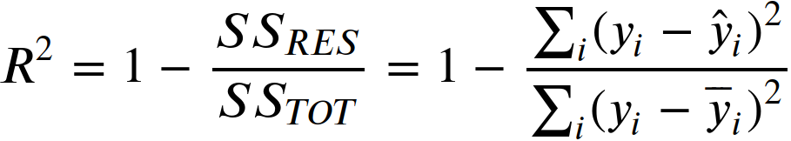
Coefficient of determination (R-squared)
Data Analysis
Lecture 6
Linear Regression
R-squared is the proportion of variation in the dependent variable that is accounted for by the model. Value of the coefficient varies from 0 to 1. An R-squared of 1 indicates that the regression predictions perfectly fit the data.

Slide 18
R-squared
Data Analysis
Lecture 6
Linear Regression
Regression models with low R-squared values can be perfectly good models. Some fields of study have an inherently greater amount of unexplainable variation. In these areas R² values are bound to be lower. For example, studies that try to explain human behavior generally have R² values less than 50%. People are just harder to predict than things like physical processes. If we have a low R-squared value but the independent variables are statistically significant, we can still draw important conclusions about the relationships between the variables. There is a scenario where small R-squared values can cause problems. If we need to generate predictions that are relatively precise, a low R2 can be a showstopper.

Slide 19
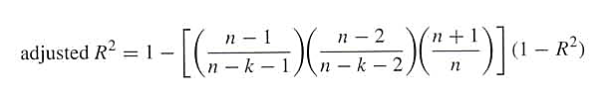
Adjusted R-squared
Data Analysis
Lecture 6
Linear Regression
Adjusted R-squared is a modified version of R-squared that has been adjusted for the number of predictors in the model. The adjusted R-squared increases when the new term improves the model more than would be expected by chance. It decreases when a predictor improves the model by less than expected. Adjusted R2 could be used to compare models that have a different amount of variables.
where n — number of cases, k — number of predictors

Slide 20
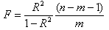
F-statistics
Data Analysis
Lecture 6
Linear Regression
The F-test compares the current model with zero predictor variables (the intercept only model), and decides whether the added coefficients significantly improved the model. If we get a significant result, then whatever coefficients we included in the model improved the model’s fit.

Slide 21
Evaluating the accuracy of the regression model
Data Analysis
Lecture 6
Linear Regression
When we have produced a model based on a sample of data two important questions should be considered:
Does the model fit the observed data well, or it’s influenced by a small number of cases?
Can the model generalize to other samples?

Slide 22
Diagnostics of the model: outliers and influential cases
Data Analysis
Lecture 6
Linear Regression
An outlier is a case which differs substantially from the main trend of the data. Outliers can cause the model to be biased because they affect the values of the estimated regression coefficients.
An influential case is a case which has serious influence over the parameters of the model. If we delete it the regression coefficients will change.

Slide 23
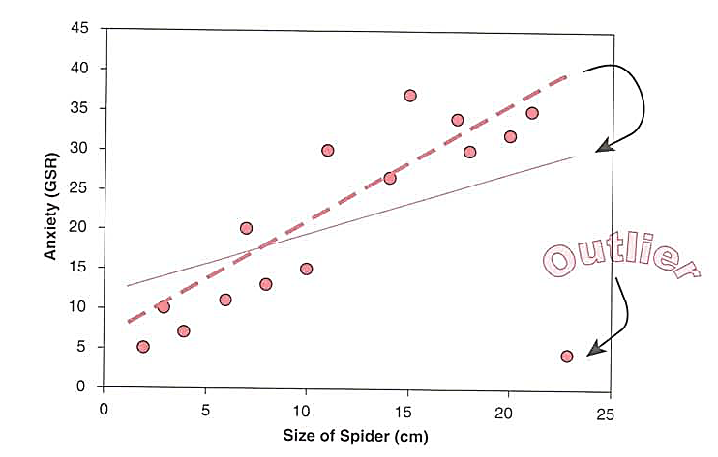
Outliers
Data Analysis
Lecture 6
Linear Regression
The change in one point had a dramatic effect on the regression model: the gradient reduced (the line becomes flatter) and the intercept increases (the line crosses the Y-axis at a higher point).

Slide 24
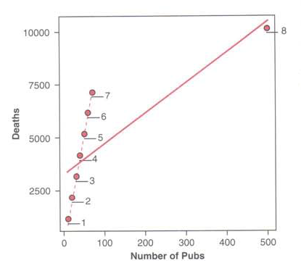
Influential cases
Data Analysis
Lecture 6
Linear Regression

Slide 25
How to identify an influential case?
Data Analysis
Lecture 6
Linear Regression
Influential statistics: DfBeta(s) shows how the regression coefficients change if the influential case is excluded.
The case could be an influential if the values of these statistics are greater than 1.

Slide 26
Diagnostics of the model: residuals
Data Analysis
Lecture 6
Linear Regression
Residuals are the differences between the values of the outcome predicted by the model and the values of the outcome observed in the sample. If the model fits the sample data well then all residuals will be small and their distribution will be not different from normal. If a particular case has a large residual then it could be an outlier. Potential outlier is a case with standardized residual greater than 3 or less than -3.

Slide 27
Multicollinearity
Data Analysis
Lecture 6
Linear Regression
Situation when there is a strong correlation (r>0.9) between two or more predictors in a regression model.
VIF (variance-inflation factor) indicates whether a predictor has a strong linear relationship with the other predictor(s). If VIF is greater than 10 there could be a multicollinearity.

Slide 28
Heteroscedasticity
Data Analysis
Lecture 6
Linear Regression
It is supposed that in good regression models the variance of the residuals is homogeneous across levels of the predicted values (homoscedasticity). If the model is well-fitted, there should be no pattern to the residuals plotted against the fitted values. If the variance of the residuals is non-constant then there is a heteroscedasticity.
The graphical analysis could detect heteroscedasticity. A commonly used graphical method is to use the plot to show the residuals versus fitted (predicted) values.

Slide 29
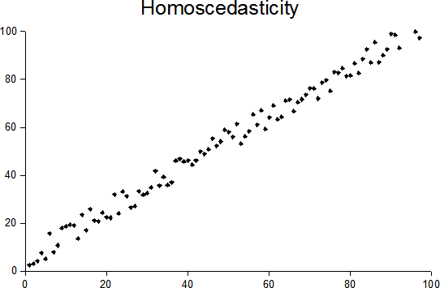
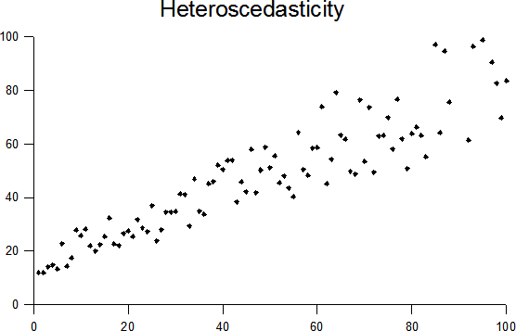
Heteroscedasticity in a simple regression model
Data Analysis
Lecture 6
Linear Regression

Slide 30
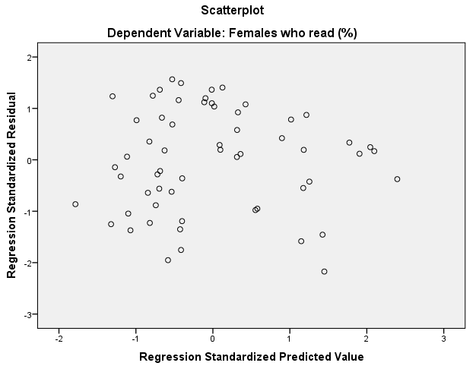
Heteroscedasticity in a multiple regression model
Data Analysis
Lecture 6
Linear Regression

Slide 31
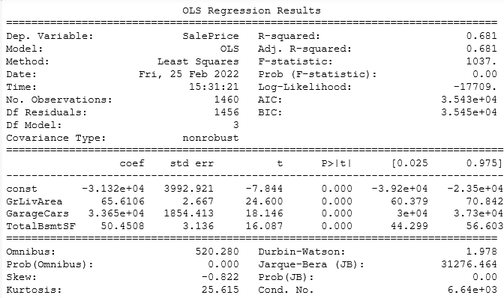
Data Analysis
Lecture 6
Linear Regression
Constant – value of the dependent variable if all the predictors are equal to zero

Slide 32
Data Analysis
Lecture 6
Linear Regression
Regression coefficient for a certain variable means that one-unit increase in variable value
will lead to an increase in the value of the dependent variable by 65.6 units

Slide 33
Data Analysis
Lecture 6
Linear Regression
Regression Equation: SalePrice = -31320 + 65,6*GrLivArea + 33650*GarageCars + 50,5*TotalBsmtSF
Regression coefficients

Slide 34
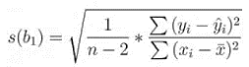
Data Analysis
Lecture 6
Linear Regression
Standard errors of regression coefficients

Slide 35

Data Analysis
Lecture 6
Linear Regression
$t=\frac{coef}{std err}$

Slide 36
Data Analysis
Lecture 6
Linear Regression
If a variable significantly predicts an outcome, then it should have a b-value significantly different from zero. This hypothesis is tested using a t-test.
Statistical significance of regression coefficients

Slide 37
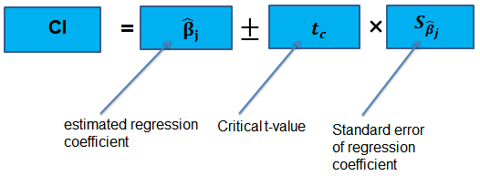
Data Analysis
Lecture 6
Linear Regression
95% confidence interval

Slide 38
Data Analysis
Lecture 6
Linear Regression
R-squared, the model explains 68% of variation of the dependent variable’s values

Slide 39
Data Analysis
Lecture 6
Linear Regression
The model is statistically significant

Slide 40
Data Analysis
Lecture 6
Linear Regression
Result of normality test for residuals: residuals are not normally distributed

Slide 41
Data Analysis
Lecture 6
Linear Regression
Skewness and Kurtosis calculated for residuals

Slide 42
Data Analysis
Lecture 6
Linear Regression
Homoscedasticity test. If the values vary from 1 to 2 there is a homoscedasticity.

Slide 43

Data Analysis
Lecture 6
Linear Regression
Normality test for the residuals

Slide 44
Useful links
Data Analysis
Lecture 6
Linear Regression
https://dss.princeton.edu/online_help/analysis/regression_intro.htm
https://datatofish.com/statsmodels-linear-regression/
https://medium.com/swlh/interpreting-linear-regression-through-statsmodels-summary-4796d359035a

Slide 45
Thank you for your attention!
Faculty of Computer Science
Data Analysis
Moscow 2022

